Slide 1


Entity Framework Core
What's New and
Better Performance Tips
09/2022

Slide 2


TABLE OF CONTENTS
01.
04.
06.
What is EF Core?
What’s new in EF Core 8?
Performance Tips
02.
05.
07.
What’s new in EF Core 6?
What’s next?
Discussion
03.
What’s new in EF Core 7?

Slide 3


What is EF Core?

Slide 4
What is EF Core?
Lightweight, Extensible, Open Source: EF Core is a modern version of the classic Entity Framework, designed to be more lightweight and flexible.
Object-Relational Mapper (O/RM): Allows .NET developers to work with a database using .NET objects and reducing the need for manual data-access code.
Database Support: It supports many database engines, with the ability to query and save data using a model composed of entity classes and a context object
Cross-Platform: Works across different platforms, making it versatile for various applications.
Migrations & Model Creation: EF Core uses migrations to evolve the database schema as the model changes, enabling the creation of a database from the model
LINQ Queries: Utilizes Language Integrated Query (LINQ) for retrieving data.
Change Tracking: EF Core automatically tracks changes made to instances of your entity classes and applies those changes to the database when SaveChanges() is called.

Slide 5
What’s new in EF Core 6?

Slide 6
What’s new in EF Core 6?
SQL Server temporal tables
Migration Bundles
Pre-convention model configuration
Compiled models
Improved performance on TechEmpower Fortunes
Azure Cosmos DB provider enhancements
Improvements to scaffolding from an existing database
LINQ query enhancements
New mapping attributes
Model building improvements
DbContext factory improvements
Miscellaneous improvements
Microsoft.Data.Sqlite 6.0

Slide 7
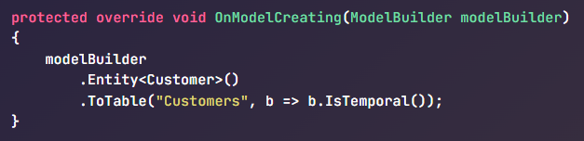
What’s new in EF Core 6?
Temporal tables
Temporal tables automatically keep track of all the data ever stored in a table, even after that data has been updated or deleted
Historical data can be queried, such as for auditing, or restored

Slide 8
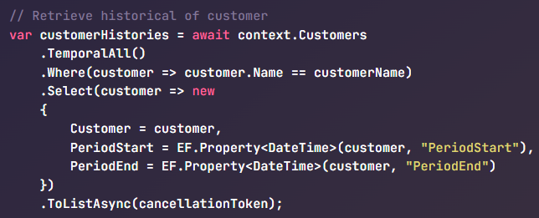
What’s new in EF Core 6?
Supported operators
TemperalAsOf
TemporalAll
TemporalFromTo
TemporalBetween
TemporalContainedIn
Notes:
EF Core supports several temporal table query operators:
TemporalAsOf: Returns rows that were active (current) at the given UTC time. This is a single row from the history table for a given primary key.
TemporalAll: Returns all rows in the historical data. This is typically many rows from the history table for a given primary key.
TemporalFromTo: Returns all rows that were active between two given UTC times. This may be many rows from the history table for a given primary key.
TemporalBetween: The same as TemporalFromTo, except that rows are included that became active on the upper boundary.
TemporalContainedIn: : Returns all rows that started being active and ended being active between two given UTC times. This may be many rows from the history table for a given primary key.
https://devblogs.microsoft.com/dotnet/prime-your-flux-capacitor-sql-server-temporal-tables-in-ef-core-6-0/
https://learn.microsoft.com/en-us/ef/core/what-is-new/ef-core-6.0/whatsnew#sql-server-temporal-tables

Slide 9

What’s new in EF Core 6?
Migration Bundles
A small executable containing migrations and the code needed to apply these migrations to the database
DevOps friendly
Work with any providers that support migrations
Notes:
https://learn.microsoft.com/en-us/ef/core/what-is-new/ef-core-6.0/whatsnew#migration-bundles
By default, the bundle uses the database connection string from your application's configuration. However, a different database can be migrated by passing the connection string on the command line. For example:
.\efbundle.exe --connection "Data Source

Slide 10
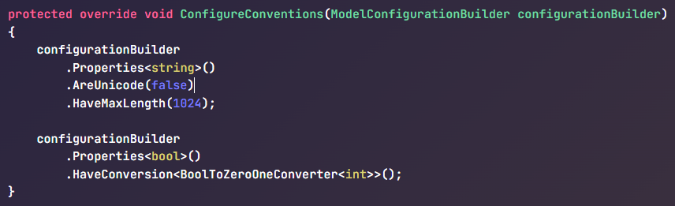
What’s new in EF Core 6?
Pre-convention model configuration
Simplifies the model configuration
Allows the mapping configuration to be specified once for a given CLR type; that configuration is then applied to all properties of that type in the model as they are discovered
Notes:
Model Bulk Configuration - EF Core | Microsoft Learn
https://devblogs.microsoft.com/dotnet/announcing-entity-framework-core-6-0-preview-6-configure-conventions/
https://learn.microsoft.com/en-us/ef/core/what-is-new/ef-core-6.0/whatsnew#pre-convention-model-configuration

Slide 11
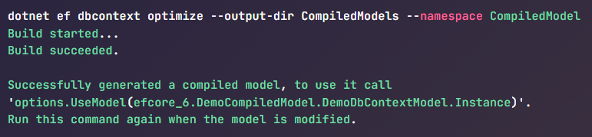
What’s new in EF Core 6?
Compiled models
Compiled models can improve EF Core startup time for applications with large models.
(100s -> 1000s of entity types and relationships)
Any changes to the model require regenerating and redeploying the compiled model
it’s most beneficial for applications with a stable model that doesn’t change frequently.

Slide 12
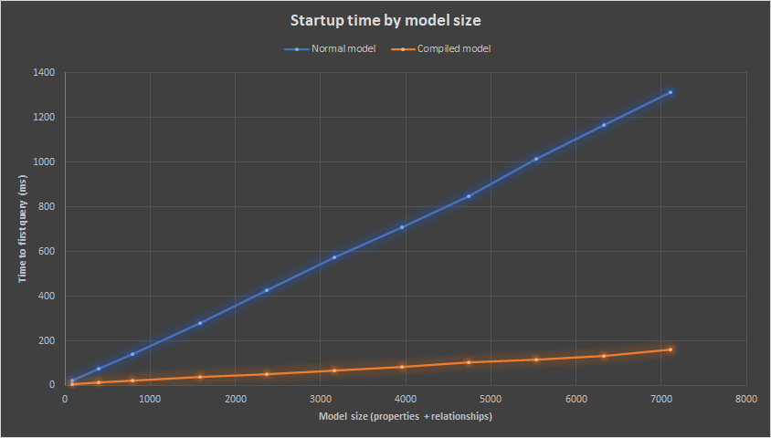
What’s new in EF Core 6?
src: Microsoft
Notes:
https://github.com/dotnet/EntityFramework.Docs/tree/main/samples/core/Miscellaneous/CompiledModels

Slide 13
What’s new in EF Core 7?

Slide 14
What’s new in EF Core 7?
JSON Columns
ExecuteUpdate and ExecuteDelete (Bulk updates)
Faster SaveChanges
Table-per-concrete-type (TPC) inheritance mapping
Custom Reverse Engineering Templates
Model building conventions
Stored procedure mapping
New and improved interceptors and events
Query enhancements
DbContext API and behavior enhancements
Model building enhancements
Improved value generation
Migrations tooling improvements
Performance enhancements for proxies
First-class Windows Forms data binding

Slide 15
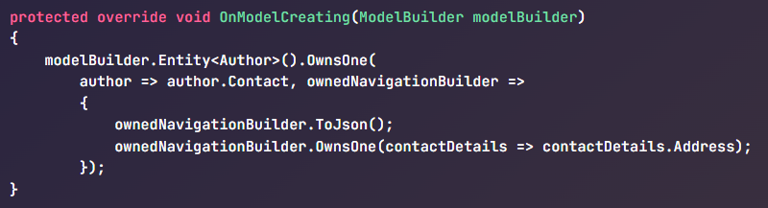
What’s new in EF Core 7?
JSONs Columns
JSON columns allow relational databases to take on some of the characteristics of document databases, creating a useful hybrid between the two.
Normal LINQ queries can be used on the aggregates, and these will be translated to the appropriate query constructs needed to drill into the JSON.
Supports updating and saving changes to JSON documents.

Slide 16
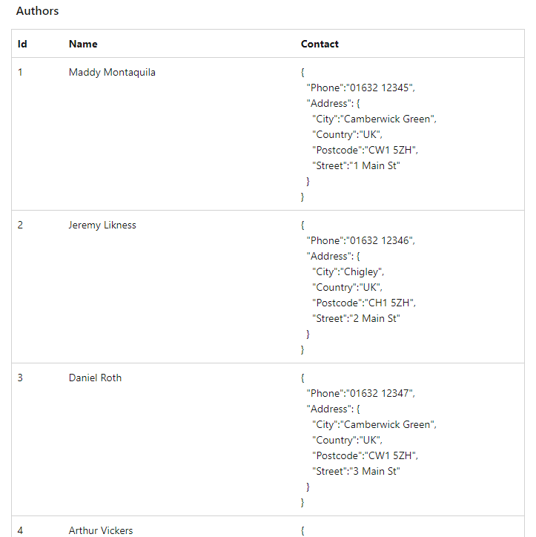
What’s new in EF Core 7?
JSONs Columns

Slide 17

What’s new in EF Core 7?
ExecuteUpdate and ExecuteDelete (Bulk updates)
Update or delete entities in the database based on the results of a query
Update many entities in the single command -> more efficient in updates and deletes

Slide 18
What’s new in EF Core 7?
New Interceptors
EF Core interceptors enable interception, modification, and/or suppression of EF Core operations
Enhanced interceptors:
IMaterializationInterceptor
IQueryExpressionInterceptor
ISaveChangesInterceptor
IDbConnectionInterceptor
IDbTransactionInterceptor
IDbCommandInterceptor
…
Notes:
Interception for creating and populating new entity instances (aka "materialization")
Interception to modify the LINQ expression tree before a query is compiled
Interception for optimistic concurrency handling (DbUpdateConcurrencyException)
Interception for connections before checking if the connection string has been set
Interception for when EF Core has finished consuming a result set, but before that result set is closed
Interception for creation of a DbConnection by EF Core
Interception for DbCommand after it has been initialized
IDbCommandInterceptor: Intercepts the execution of a database command.
IDbConnectionInterceptor: Intercepts the opening and closing of a database connection.
IDbTransactionInterceptor: Intercepts transactions-related events.
ISaveChangesInterceptor: Intercepts the SaveChanges and SaveChangesAsync methods.
IQueryInterceptor: Intercepts LINQ query operations.
INavigationInterceptor: Intercepts navigation property loading.
IEntityMaterializationInterceptor: Intercepts when an entity is materialized from a database result set.
IOptimisticConcurrencyInterceptor: Intercepts optimistic concurrency exceptions.
IDbConnectionInterceptor: Intercepts connection-related events, such as when a connection is created or opened.

Slide 19
What’s new in EF Core 8?

Slide 20
What’s new in EF Core 8?
Value objects using Complex Types
Primitive collections
Enhancements to JSON column mapping
HierarchyId in .NET and EF Core
Raw SQL queries for unmapped types
Enhancements to lazy-loading
Access to tracked entities
Model building
Enhancements to Math translations
Checking for pending model changes
Better ExecuteUpdate and ExecuteDelete
Better use of IN queries
Parentheses elimination
Specific opt-out for RETURNING/OUTPUT clause
Other minor changes

Slide 21
What’s new in EF Core 8?
Value objects using Complex Types
"Complex Types" to cover objects that are structured to hold multiple values, but the object has no key defining identity. For example: Address, Coordinate…
Complex type objects:
Are not identified or tracked by key value.
Must be defined as part of an entity type.
(In other words, you cannot have a DbSet of a complex type.)
Can be either .NET value types or reference types.
Instances can be shared by multiple properties.

Slide 22
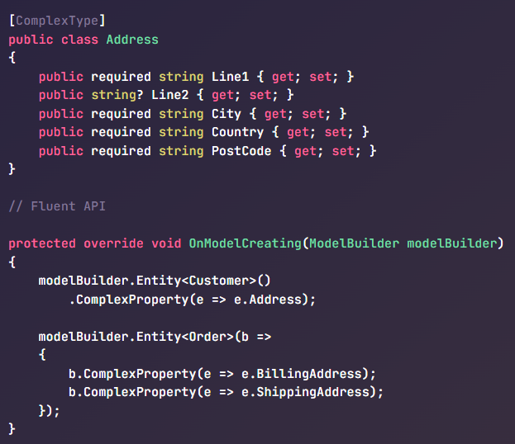
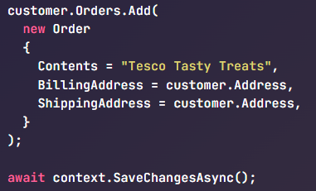
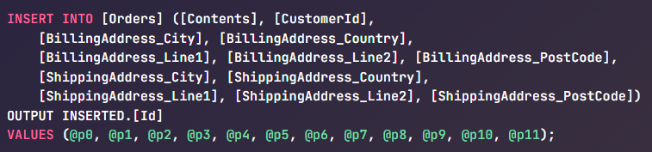
What’s new in EF Core 8?

Slide 23
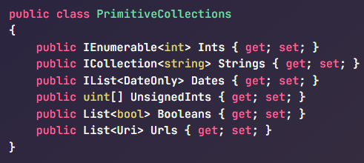
What’s new in EF Core 8?
Primitive collections
Map simple value types, such as int, string, or DateTime, to a collection property in entity class.
Work with collections of simple values more intuitively and efficiently
The sql query will include OPENJSON table-valued function

Slide 24
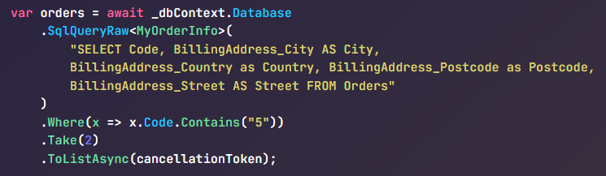
What’s new in EF Core 8?
Raw SQL queries for unmapped types
Built-in support for raw SQL queries returning any mappable CLR type, without including that type in the EF model.
Queries using unmapped types are executed using SqlQuery or SqlQueryRaw
Returns an IQueryable which can be composed on using LINQ
Types used in this way do not have keys defined and cannot have relationships to other types

Slide 25
What’s new in EF Core 8?
Official HierarchyId Support for SQL Server
Store hierarchical data, that forms a tree structure, where each item can have a parent and/or children
The HierarchyId type can be used for properties of an entity type.
Use of HierarchyId for EF Core functionality such as queries and updates requires the Microsoft.EntityFrameworkCore.SqlServer.HierarchyId package

Slide 26
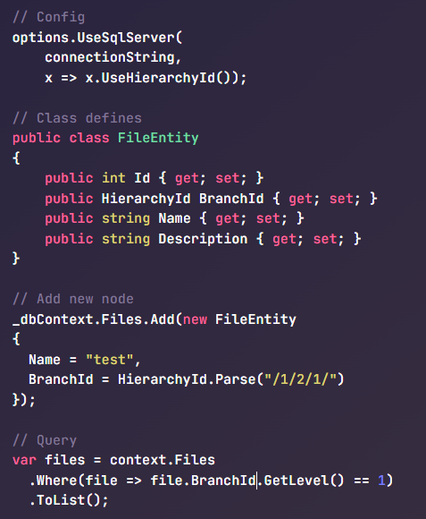
What’s new in EF Core 8?

Slide 27
What’s next?

Slide 28
What’s next after EF Core 8?
EF Core 9 (EF 9)
Scheduled: November 2024
Targets: .NET 8
Expected:
LINQ and SQL translation: Architecture changes for better JSON mapping.
ExecuteUpdate and ExecuteDelete: New methods for updating and deleting data.
Migrations: Continued improvements for model changes and database evolution.
Model building: Enhancements in defining models and relationships.
Aims to support Native AOT (Ahead-of-Time compilation)

Slide 29
Performance Tips

Slide 30
Performance tips
Retrieve only the data you need
Split your large data context into many smaller data contexts
Use batch updates for large numbers of entities
Disable change tracking for read-only queries
Write SQL by hand when necessary
Use profiling tools to identify performance bottlenecks and measure the impact of changes
Query caching and parameterization
Interceptors
Compiled Model
Compiled Query
DbContext Pooling
Notes:
https://learn.microsoft.com/en-us/ef/core/providers/sql-server/memory-optimized-tables

Slide 31
Performance tips
Interceptors
Detecting Inefficient Queries
Caching
Batching
Connection Management
Transaction Management
Notes:
Detecting Inefficient Queries: Interceptors can be used to detect and warn about inefficient queries, such as those that retrieve more data than necessary. This can help developers identify and optimize these queries.
Caching: Interceptors can be used to implement caching strategies, which can significantly improve performance for read-heavy workloads.
Batching: Interceptors can be used to implement batching of database operations, reducing the number of round-trips to the database.
Connection Management: Interceptors provide control over the opening and closing of connections, which can be optimized for performance.
Transaction Management: Interceptors provide control over transactions, allowing for optimizations such as transaction batching.

Slide 32
Performance tips
Compiled Query
Allow the explicit compilation of a LINQ query into a .NET delegate. Once this delegate is acquired, it can be invoked directly to execute the query, without providing the LINQ expression tree
Provide a pre-compiled, cached and reusable query
When to use:
The query is executed multiple times, varying with parameters
You do not intend to further change the query

Slide 33
Performance tips
DbContext Pooling
Reducing runtime overhead
EF Core can pool your context instances: when you dispose your context, EF Core resets its state and stores it in an internal pool; when a new instance is next requested, that pooled instance is returned instead of setting up a new one.

Slide 34
Reference
What’s new in EF Core 6?
What’s new in EF Core 7?
What’s new in EF Core 8?
Plan for EF Core 9
How to improve data access perfomance in EF Core
Hierarchical Data
EF Core Performance

Slide 35
DISCUSSION

Slide 36

THANK YOU!

